Slide 1


Predicting Health Insurance Premiums in the US
DATAS6103 – Data Mining Project
Keerthana Aravindhan | Vamsidhar Boddu| Amit Sopan Shendge
Source: https://www.kaggle.com/datasets/sridharstreaks/insurance-data-for-machine-learning/data

Slide 2
Predicting Health Insurance Premiums in the US
DATAS6103 – Data Mining Project
Keerthana Aravindhan | Vamsidhar Boddu| Amit Sopan Shendge
Source: https://www.kaggle.com/datasets/sridharstreaks/insurance-data-for-machine-learning/data

Slide 3
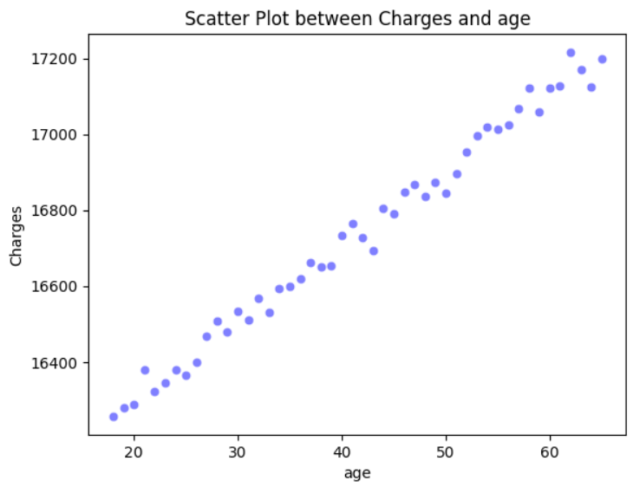
Scatterplot of age vs charges:
Average charges for each age.
Charges increases with increase in age.

Slide 4
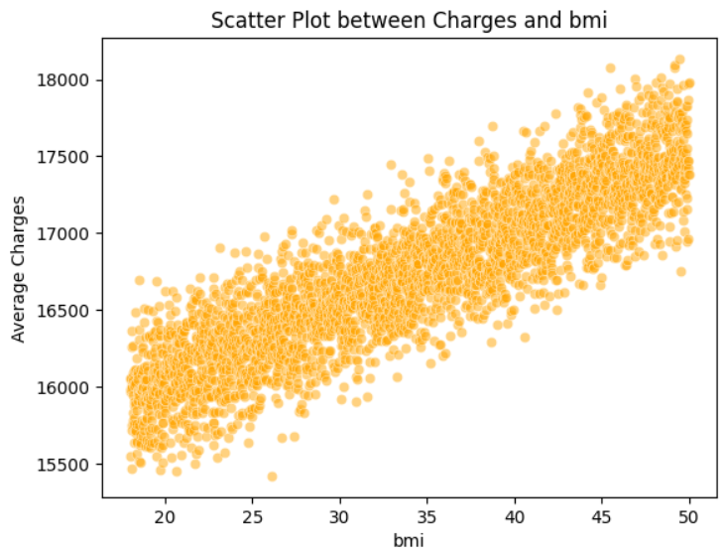
Scatterplot of bmi vs charges:
Average charges for each bmi.
Charges increases with increase in BMI.

Slide 5
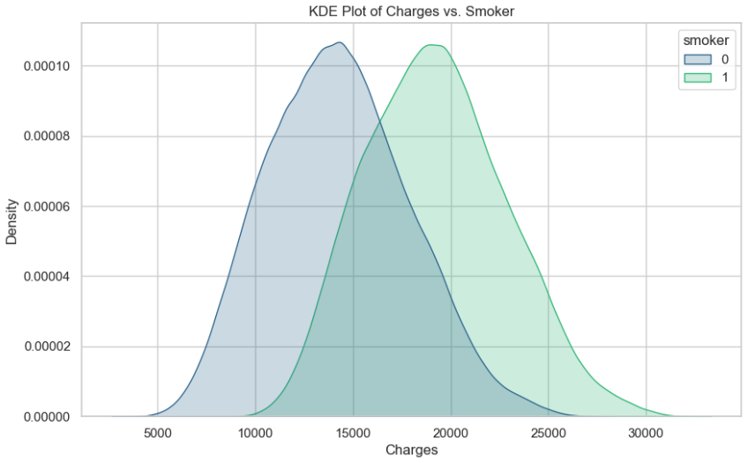
plot of charges vs smokers
The KDE plot clearly illustrates that more of Smokers tend to incur higher charges compared to non-smokers.
Also from the t-test we could find that there is significant difference in charges between smoker.

Slide 6
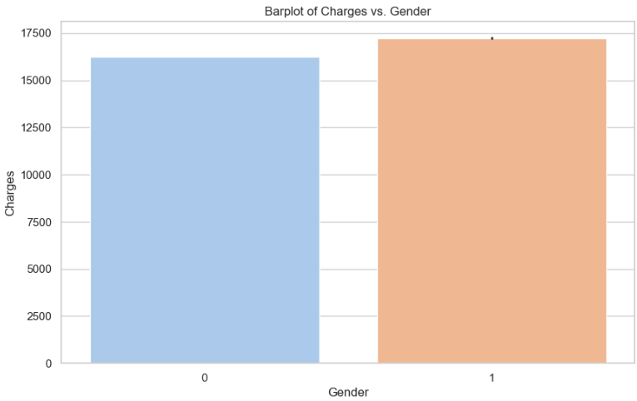
barplot of charges vs gender
On average, males tend to give higher charges than females.
Additionally, the maximum charge in the dataset is paid by a male, while the minimum charges are associated with females.
This states that in general there is gender-based disparities.
Also from the t-test we could find that there is significant difference in charges between gender.

Slide 7
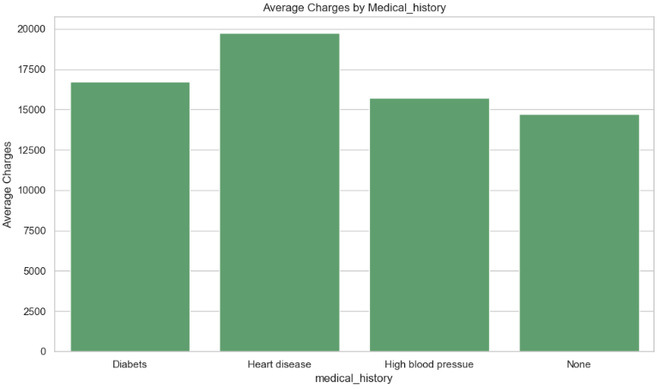
Average charges vs medical history
The average charges are notably higher for individuals with heart disease, followed by those with diabetes.

Slide 8
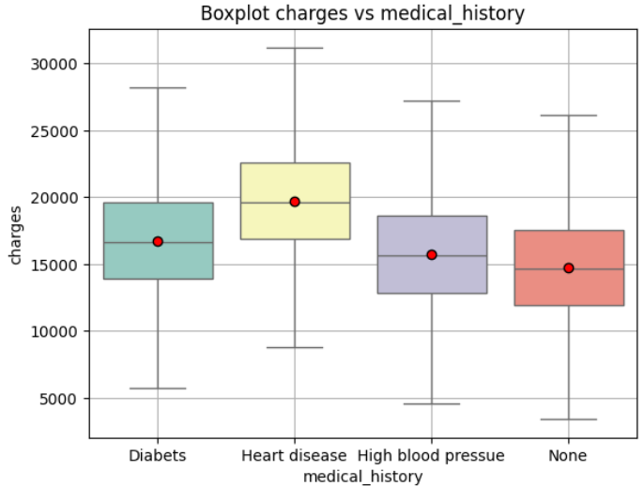
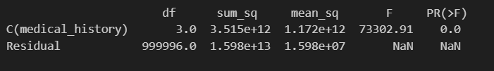
Anova test between medical history
And charges
There is significant difference among the means of medical history groups of charges
The Tukey HSD test further confirms that all pairwise differences are statistically significant.

Slide 9
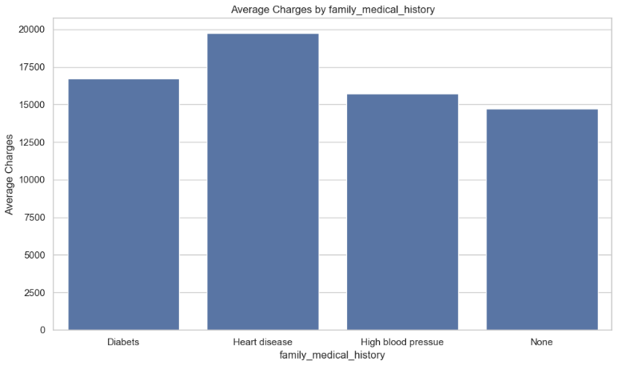
Average charges vs family medical history
The average charges are notably higher for individuals with heart disease, followed by those with diabetes in family_medical_history also.
From One way Anova test, there is significant difference among the means of family medical history groups of charges

Slide 10
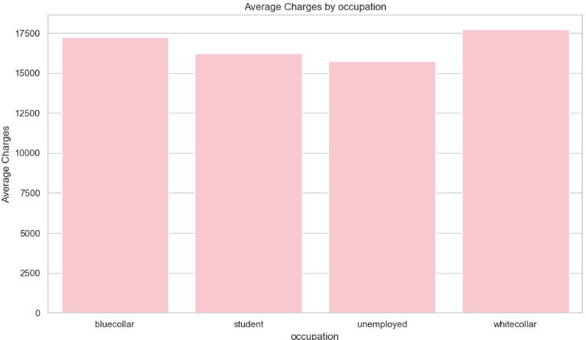
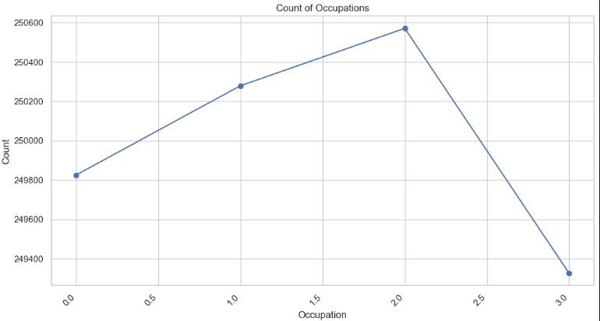
Average charges vs occupation
The average charges are notably higher for white collar occupation, followed by those in blue collar and student.
Unemployed pay less charges. Also, according to dataset, Unemployed are in more count.

Slide 11
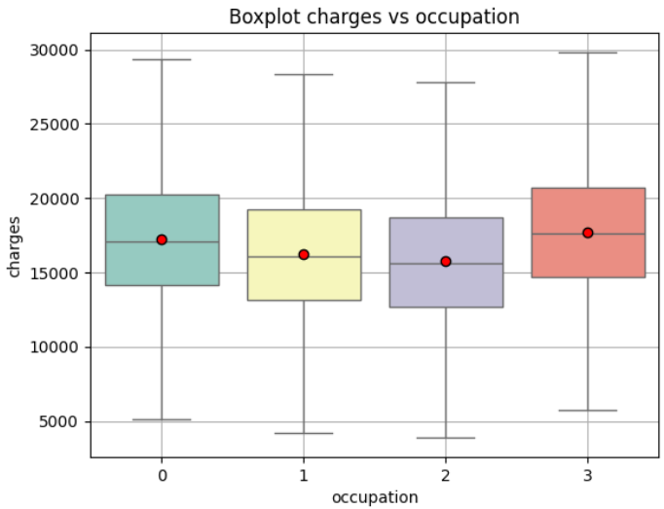

Anova test between occupation
And charges
There is significant difference among the means of occupation groups of charges
The Tukey HSD test further confirms that all pairwise differences are statistically significant.

Slide 12
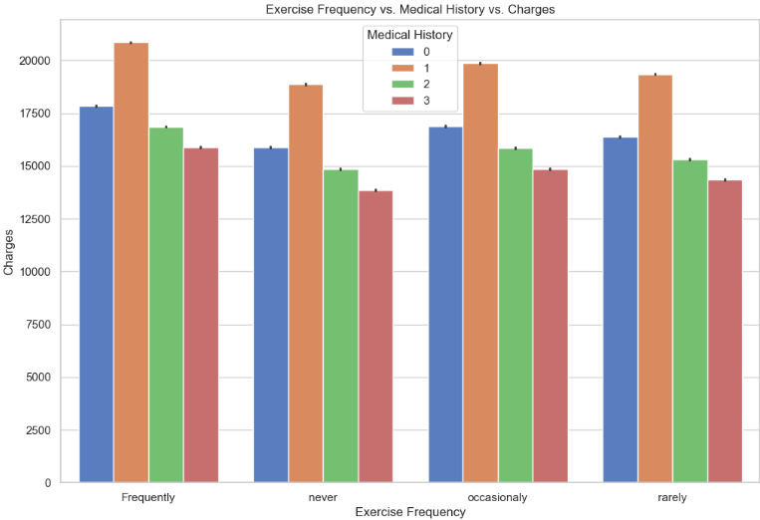
Charges according to medical history and exercise freq
Individuals who engage in frequent exercise and have a history of heart disease tend to incur higher charges. Following this, those who exercise occasionally and have a history of heart disease exhibit the high charges.
Conversely, the lowest charges are observed among individuals with no exercise regimen and no reported medical history.
Diabetes- 0 Heart disease- 1
High blood pressure- 2 None- 3

Slide 13
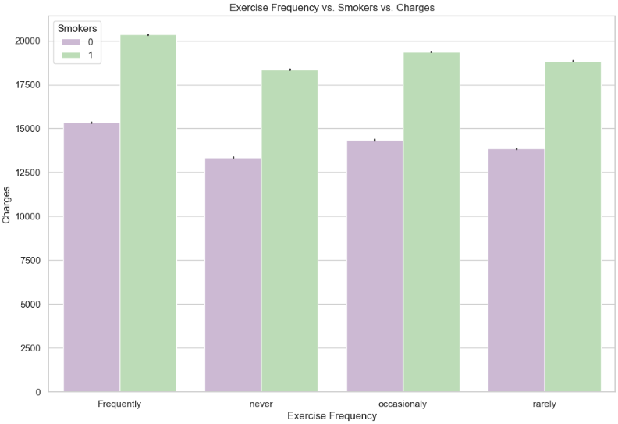
Charges according to Smoking and exercise freq
Individuals who engage in frequent exercise and have a smoking habit tend to incur higher charges. Following this, those who exercise occasionally and rarely and have smoking habit exhibit the highest charges.
Conversely, the lowest charges are observed among individuals with no exercise regimen and no smoking habit.
0 – no smoking 1 - smoking

Slide 14
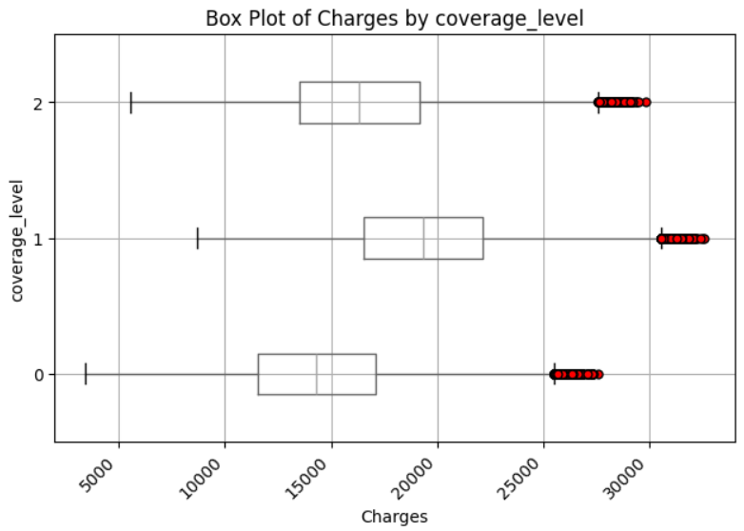
Boxplot of charges by coverage level
The analysis exactly reveals that Premium customers incur the highest charges, trailed by Standard and Basic customers in descending order.

Slide 15
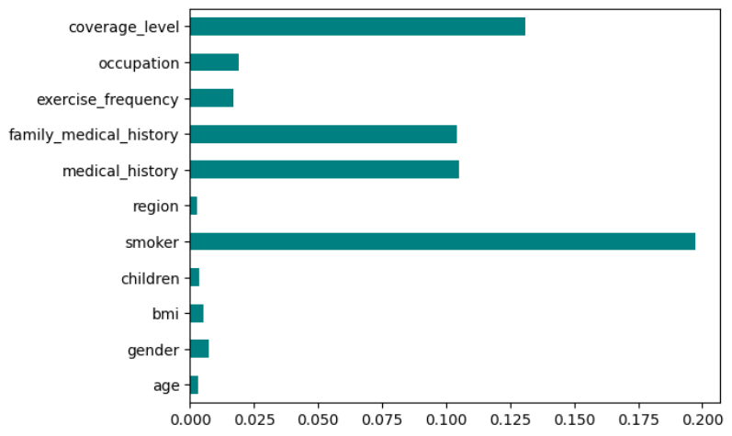
Feature selection
mutual_info_regression feature selection :
Top features influencing charges
Smoker
coverage_level
medical_history
family_medical_history

Slide 16
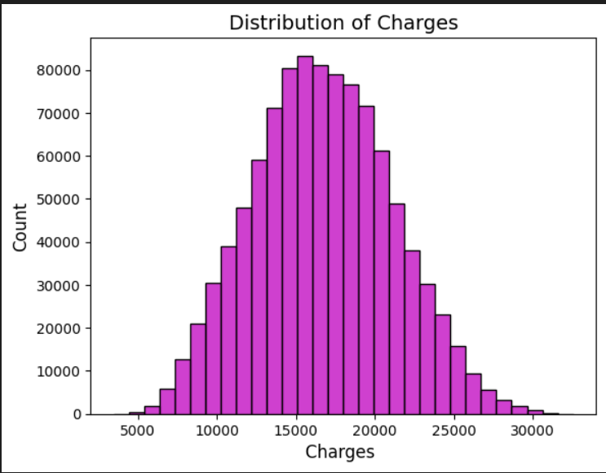
Distribution of Charges:
The dataset exhibits a notable absence of outliers, and the distribution of charges aligns closely with a normal distribution.

Slide 17
RESULTS
Regression Model | M.S.E | M.A.E | M.A.P.E | ACCURACY | Train_R2 Score | Test_R2 Score
Linear | 839240.2362 | 753.39 | 4.853283 | 95.15% | 0.9568 | 0.9568
Random Forest | 139478.7883 | 305.8503
SVM | 84801.66551 | 251.9165
Gradient Boosting | 126511.283 | 292.57 | 1.899895 | 98.10% | 0.9941 | 0.9935
XG Boost | 103509.9365 | 270.27 | 1.74592 | 98.25% | 0.9941 | 0.9947

Slide 18
Gradient Boosting Regression model
Results:
Metrics for Gradient boosting model after tuning
Mean squared error: 126511.28304750347
Average absolute error: 292.57
mean absolute percentage error (MAPE): 1.899894828242299
Accuracy: 98.1 %.
Train R2 score: 0.9941
Test R2 score: 0.9935

Slide 19
XG Boost Regression model
Results:
Metrics for XG Boost model after tuning
Mean squared error: 103509.93648385104
Average absolute error: 270.27
mean absolute percentage error (MAPE): 1.7459202766297914
Accuracy: 98.25 %.
Train R2 score: 0.9941
Test R2 score: 0.9947

Slide 20
Using prediction of health insurance premiums
Train machine learning models using historical data to predict insurance premiums.
Utilize features such as age, gender, health conditions and other relevant factors and implement below applications
Web Application.
Mobile App integration.
For online policy application.
These applications provide real-time predictions for users with the feature values provided.

Slide 21
References
Ref 1
Ref 2

Slide 22



Thank You!

